Slide 1
FBNet: Hardware-Aware Efficient ConvNet Design via Differentiable Neural Architecture Search
24 May 2019
Ляшук А. Ю. 18 ИАД, 2019

Slide 2
ConvNets
ConvNets are the de facto method for computer vision. In many computer vision tasks, a better ConvNet design usually leads to significant accuracy improvement.
In previous works, accuracy improvement comes at the cost of higher computational complexity, making it more challenging to deploy ConvNets to mobile devices, on which computing capacity is limited.

Slide 3
Problem
Mobile neural networks must be small to provide real-time prediction
Designing accurate and efficient ConvNets for mobile devices is challenging because the design space is large.
ConvNet architecture depends on factors such as input resolution and target devices.
Due to this, previous neural architecture search (NAS) methods are computationally expensive and existing approaches are too resource demanding for case-by-case redesigns.

Slide 4
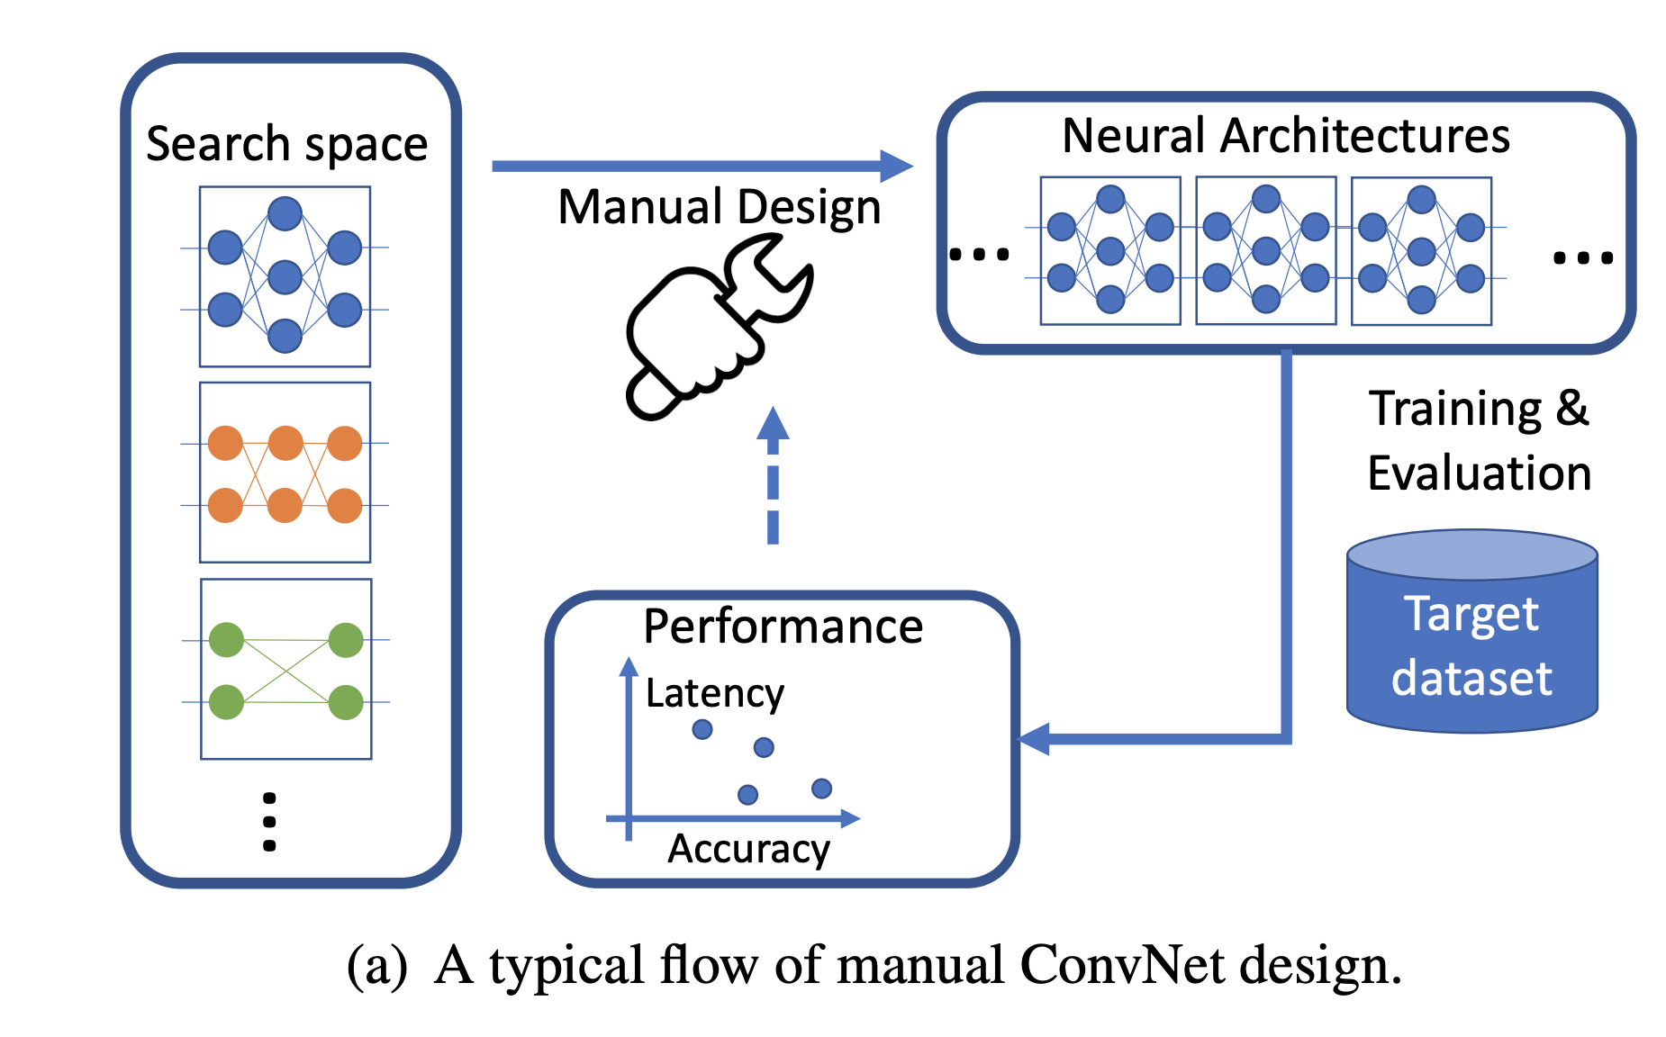
VGG16 as an example
Using VGG16 as an example: VGG16 contains 16 layers. Assume for each layer of the network, we can choose a different kernel size from {1, 3, 5} and a different filter number from {32, 64, 128, 256, 512}. Even with such simplified design choices and shallow layers, the design space contains (3 × 5)16 ≈ 6 × 1018 possible architectures.

Slide 5
Proposal
To address these, authors propose a differentiable neural architecture search (DNAS) framework that uses gradient-based methods to optimize ConvNet architectures, avoiding enumerating and training individual architectures separately as in previous methods.
FBNets (Facebook-Berkeley-Nets), a family of models discovered by DNAS surpass state-of-the-art models both designed manually and generated automatically.

Slide 6
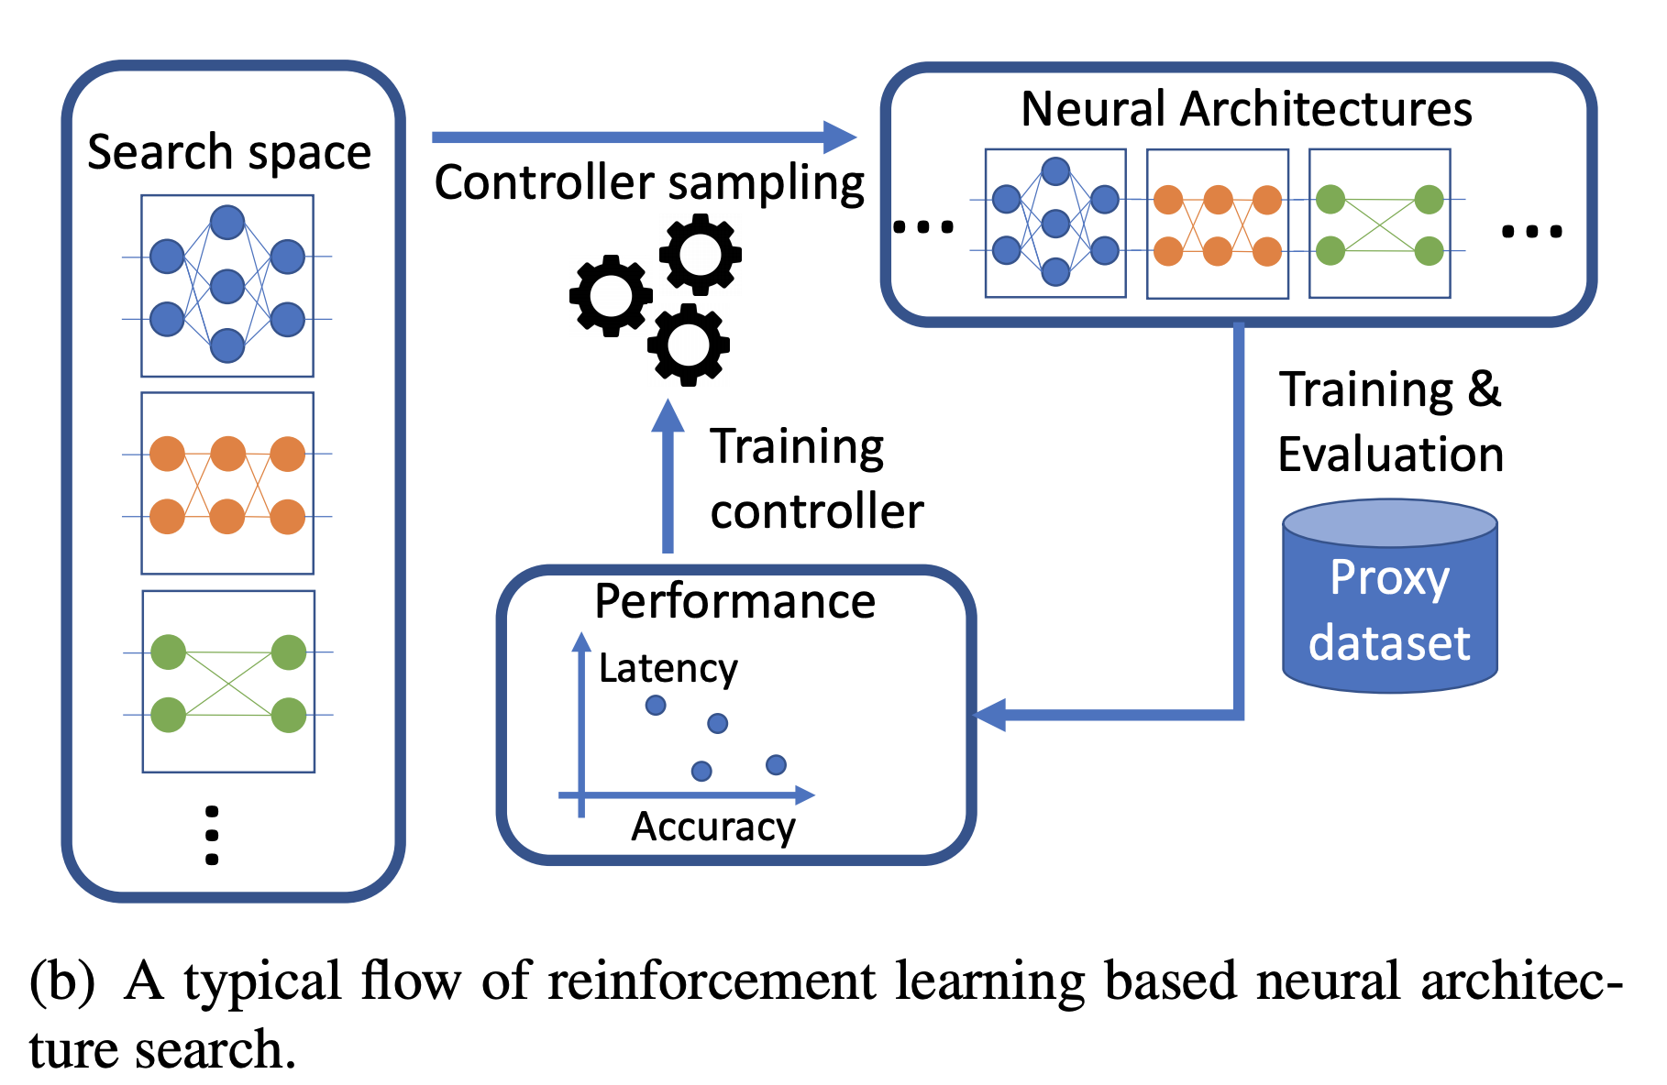
Problems
Nontransferable optimality
Inconsistent efficiency metrics
No latency, power, energy, only FLOPs
However, a ConvNet with lower FLOP count is not necessarily faster. For example, NasNetA has a similar FLOP count as MobileNetV1, but its complicated and fragmented cell-level structure is not hardware friendly, so the actual latency is slower.

Slide 7
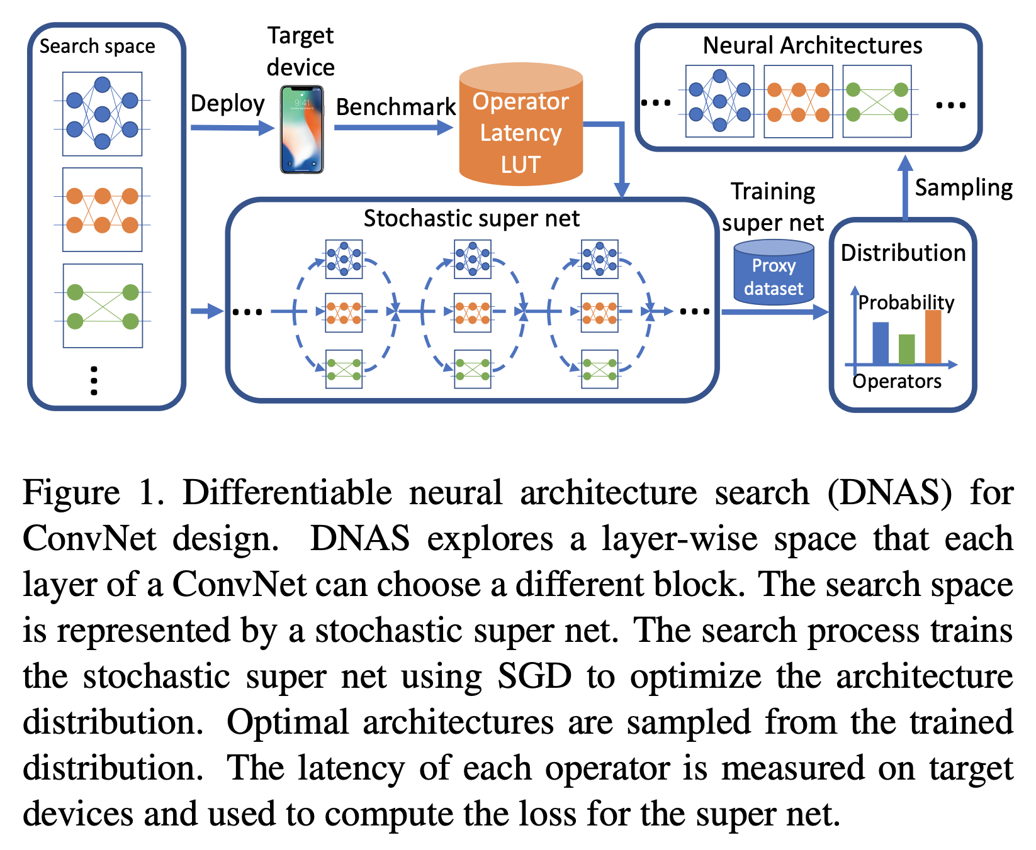
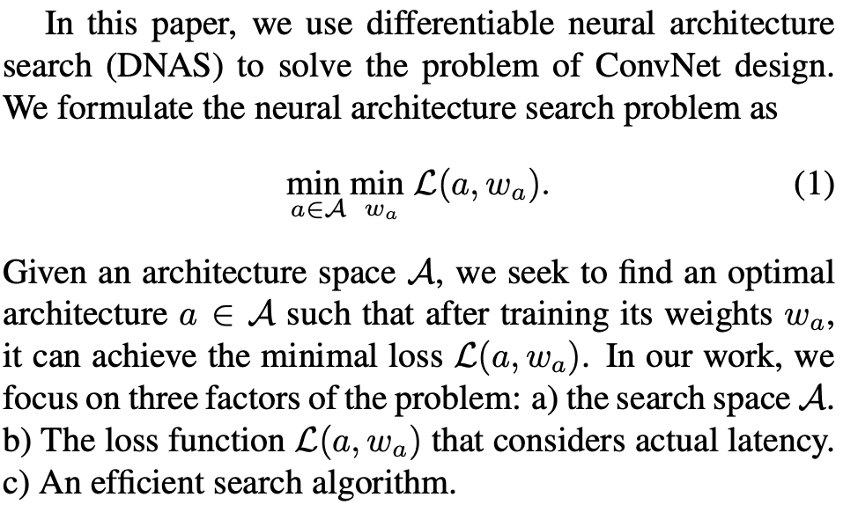
FBNet

Slide 8
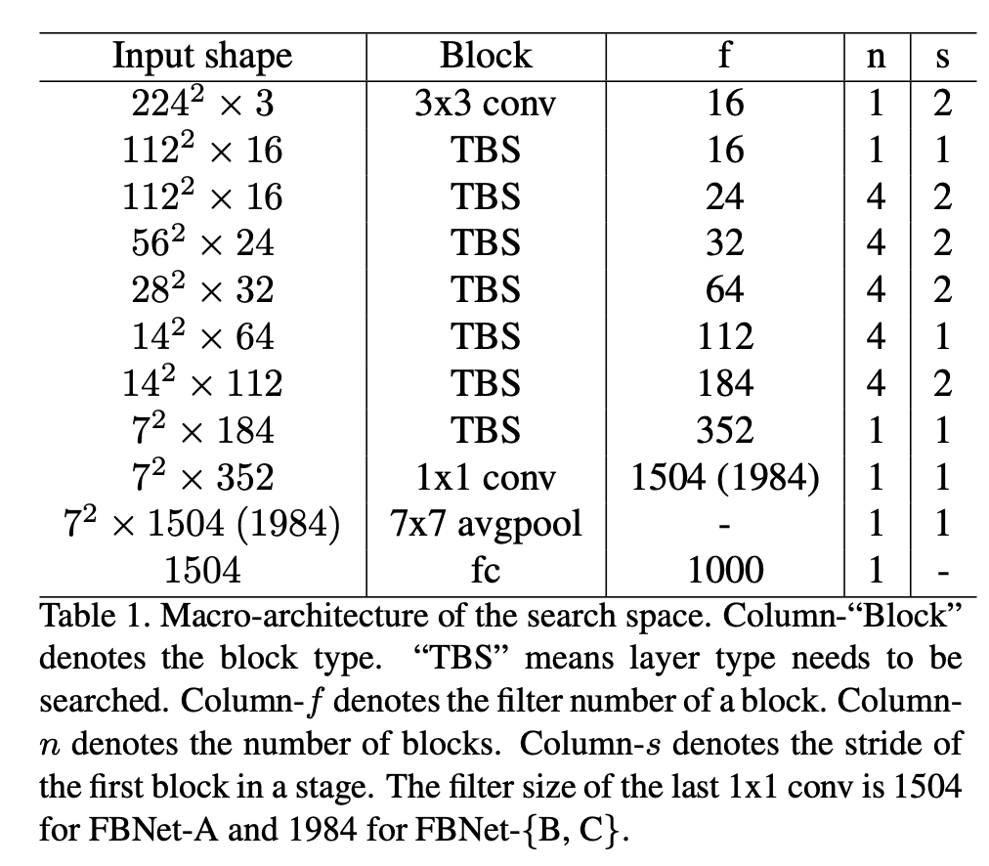
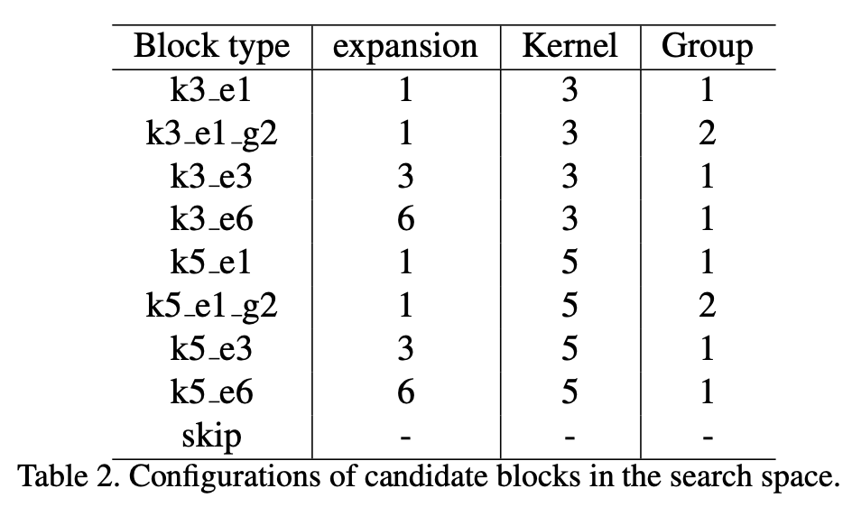
Architecture
In this work, authors construct a layer-wise search space with a fixed macro-architecture, and each layer can choose a different block.
The macro architecture defines the number of layers and the input/output dimensions of each layer. The first and the last three layers of the network have fixed operators. For the rest of the layers, their block type needs to be searched.

Slide 9
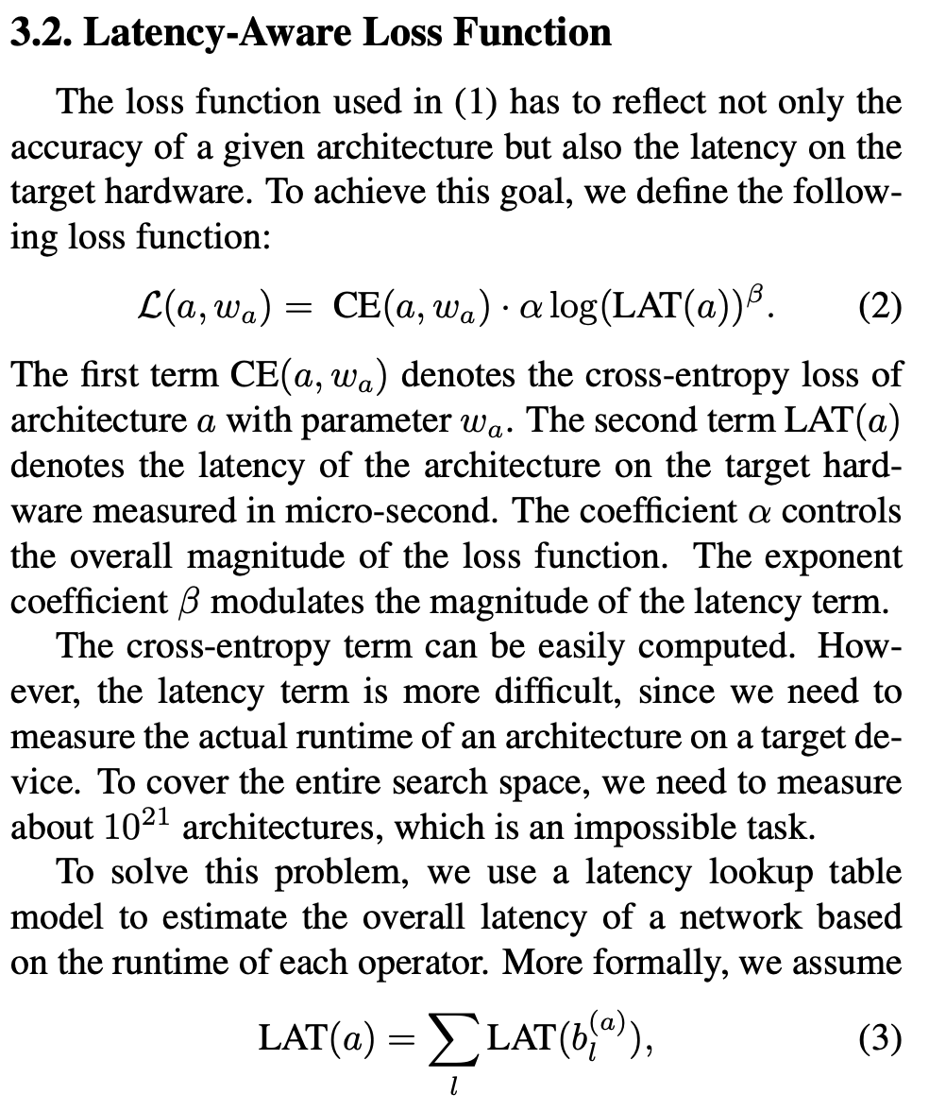
Loss

Slide 10
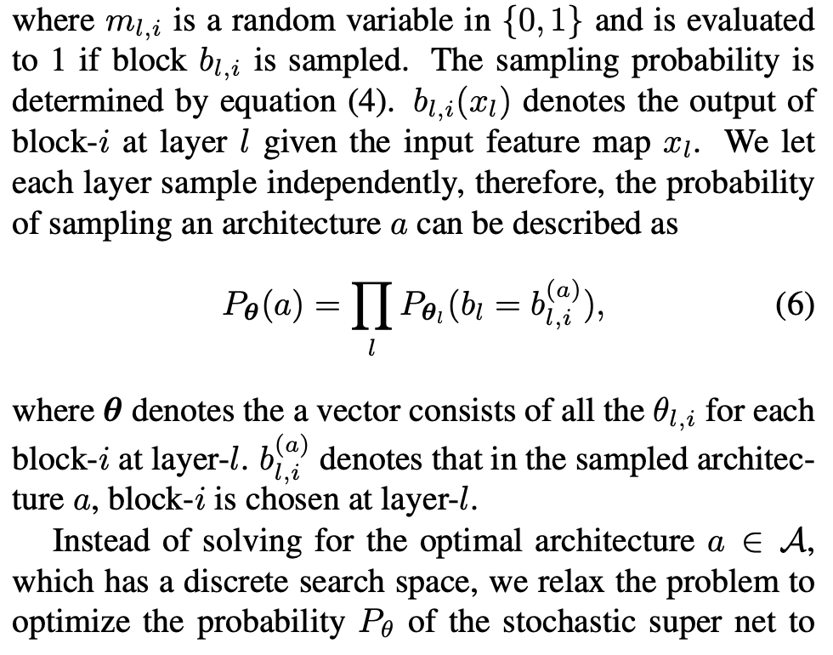
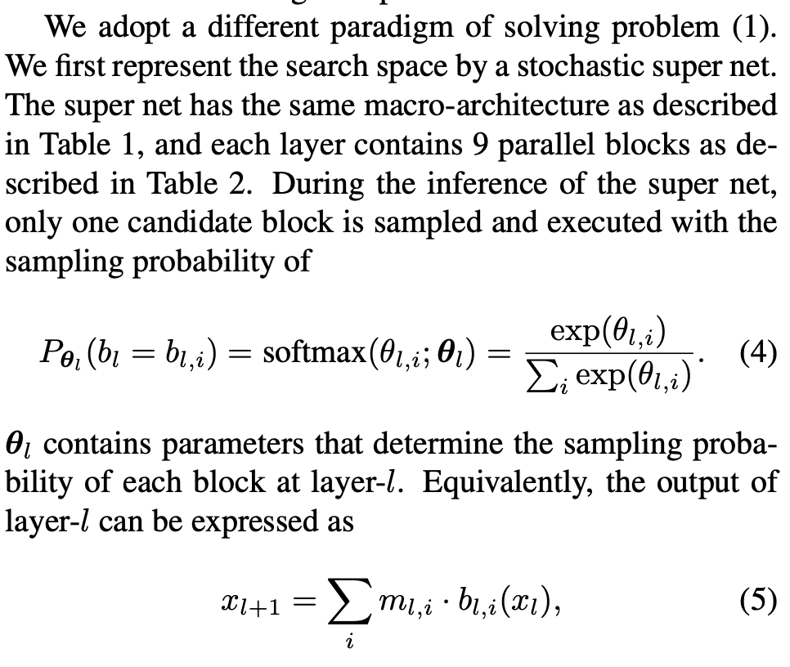
The search algorithm

Slide 11
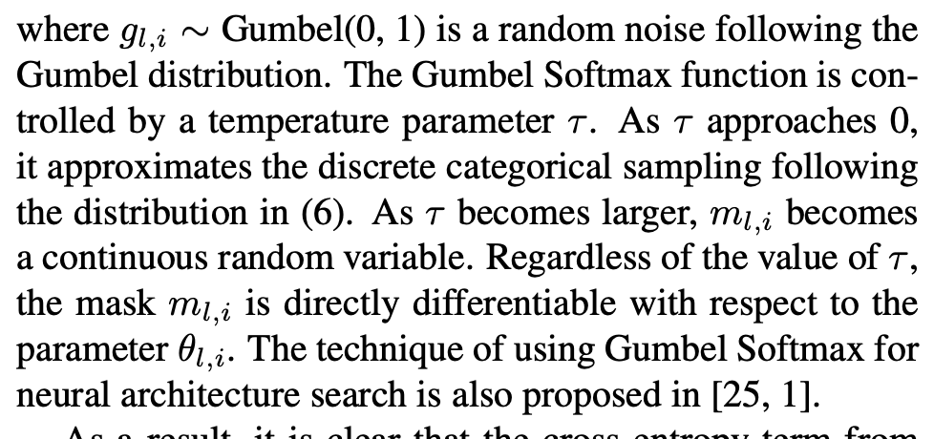
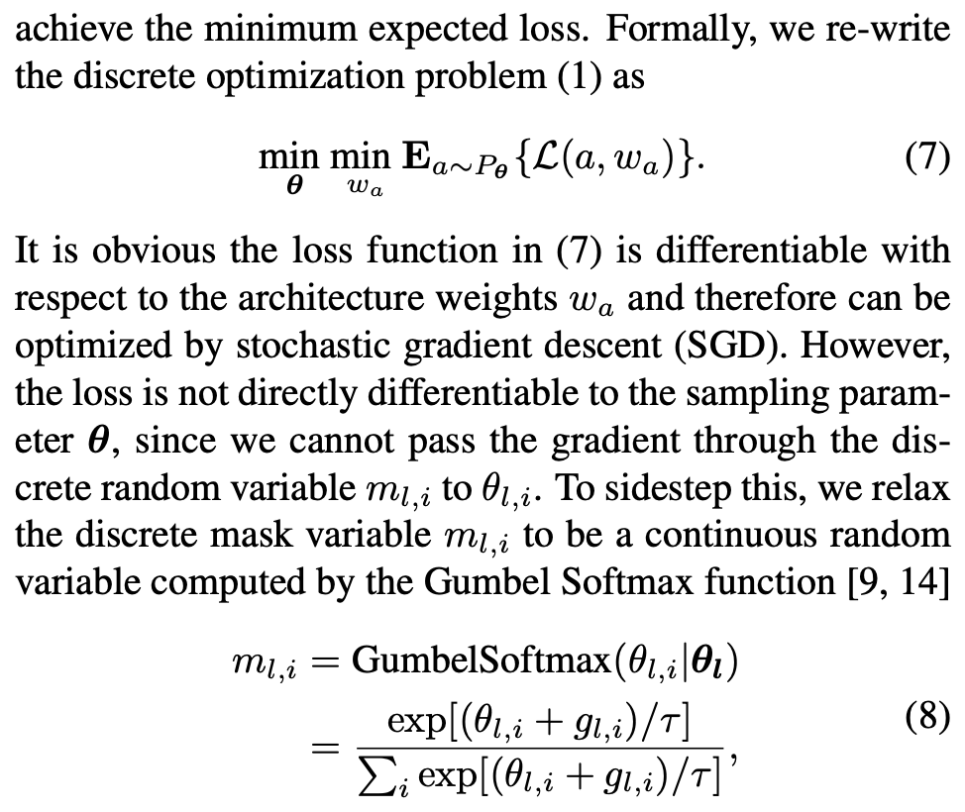
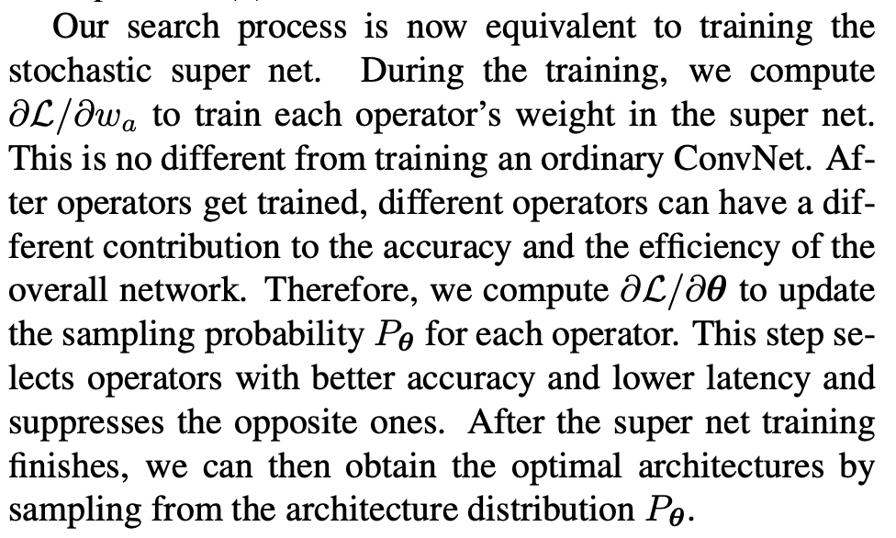
The search algorithm

Slide 12
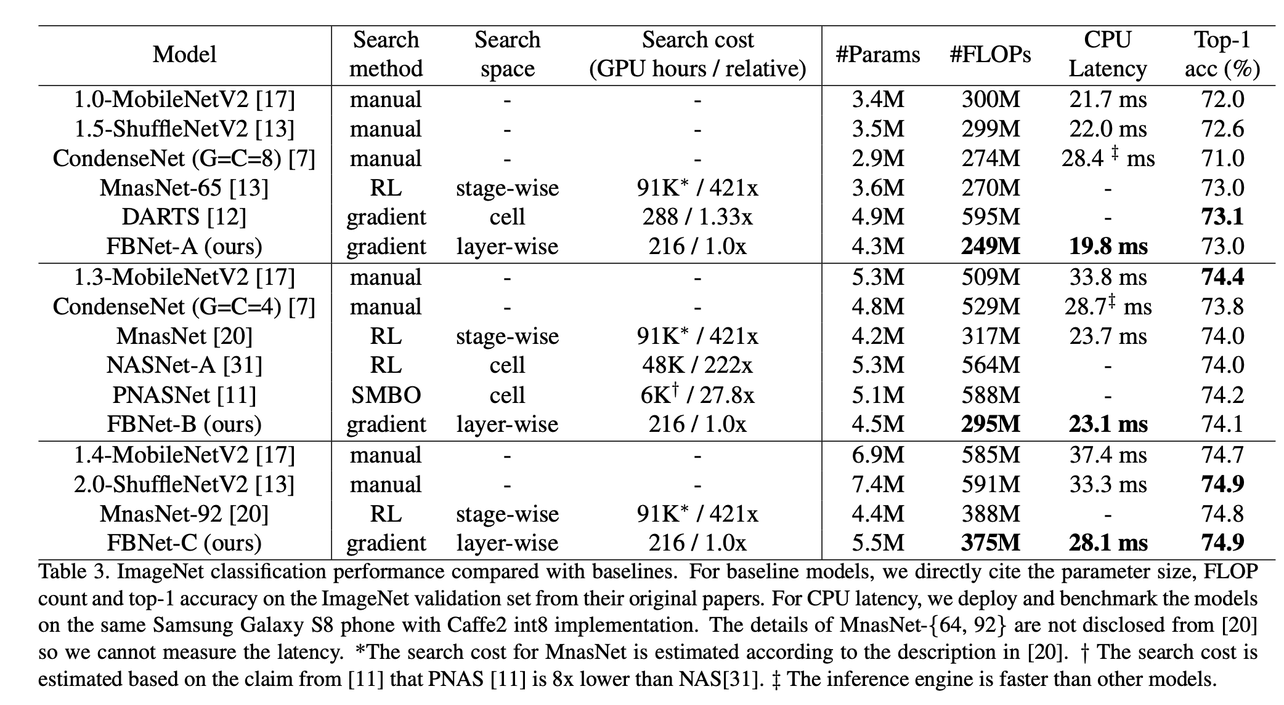
Experiments

Slide 13
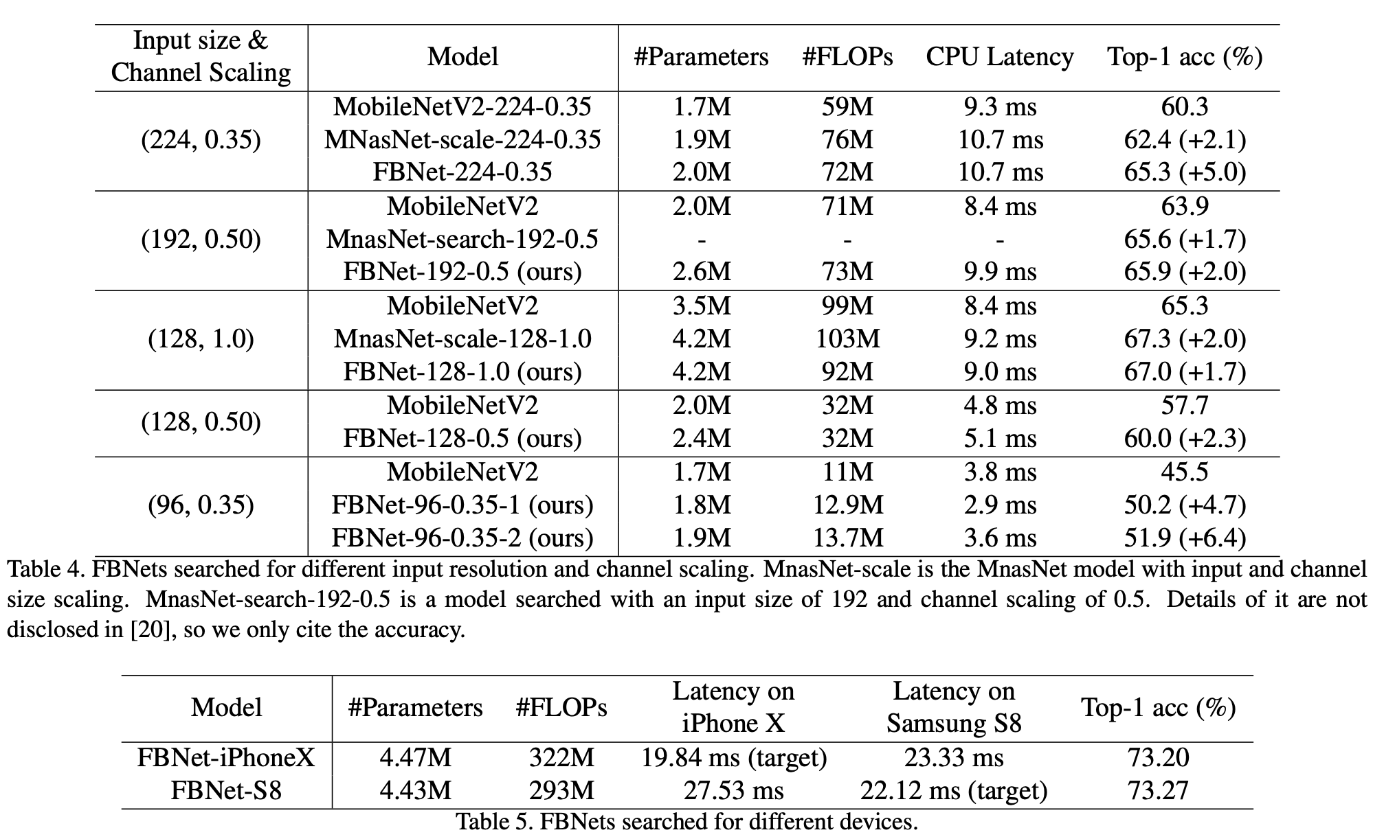
Experiments

Slide 14
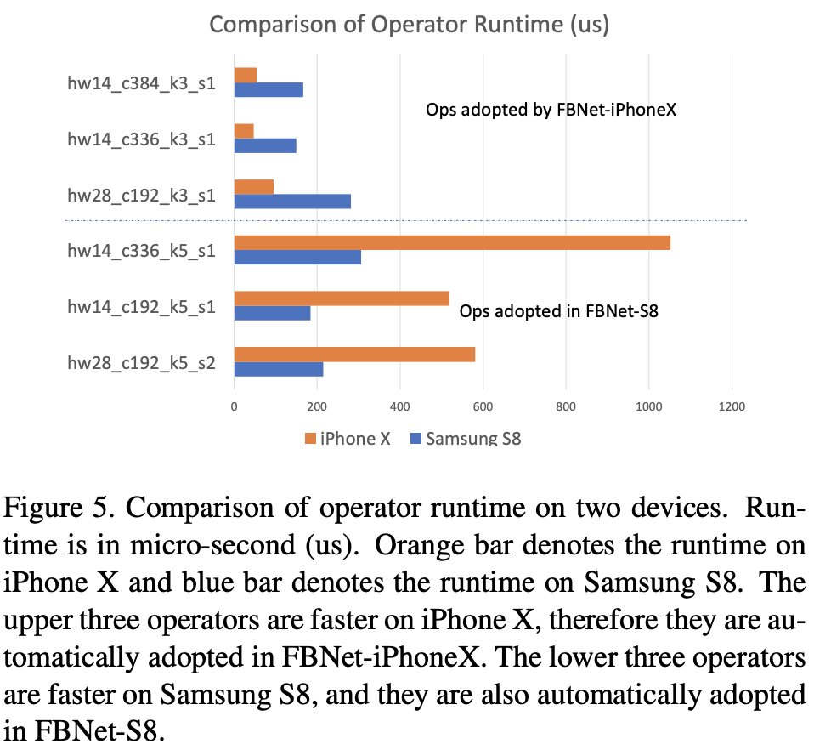
Conclusion
FBNets, a family of models discovered by DNAS surpass state-of-the-art models, both manually and automatically designed: FBNet-B achieves 74.1% top-1 accuracy with 295M FLOPs and 23.1 ms latency, 2.4x smaller and 1.5x faster than MobileNetV2- 1.3 with the same accuracy. It also achieves better accuracy and lower latency than MnasNet, the state-of-the-art efficient model designed automatically; we estimate the search cost of DNAS is 420x smaller. Such efficiency allows us to conduct searches for different input resolutions and channel scaling. Discovered models achieve 1.5% to 6.4% accuracy gains. The smallest FBNet achieves 50.2% accuracy with a latency of 2.9 ms (345 frames/sec) with batch size 1. Over the Samsung-optimized FBNet, the improved FBNet achieves 1.4x speed up on an iPhone X, showing DNAS is able to adapt to different target devices automatically.

